Slide 1
GRNsight
Nicole Anguiano
4/17/17
CMSI 402

Slide 2
Project Description
GRNsight is a web app and service for visualizing small- to medium-scale gene regulatory networks (GRNs)
Allows the user to upload a GRN in XLSX, SIF, or GraphML format
The resulting visualization can then be customized and analyzed

Slide 3
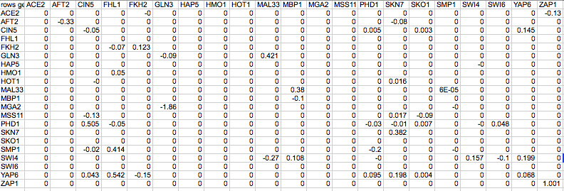
Turns this…

Slide 4
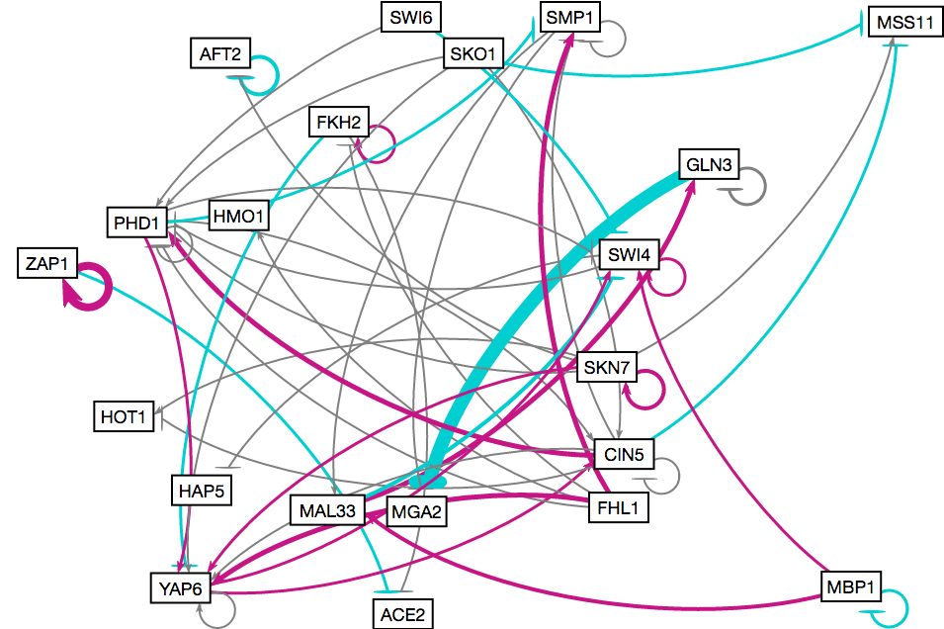
Into this…

Slide 5
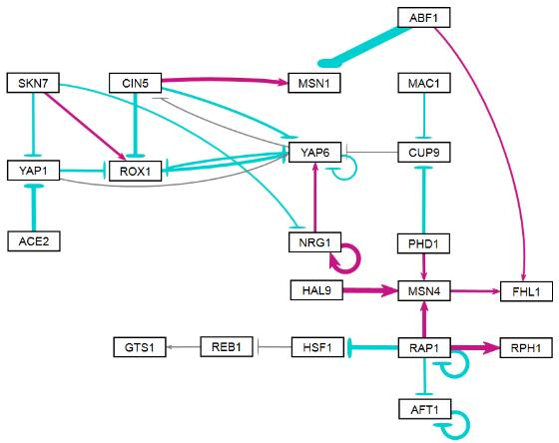
And can be customized to this!

Slide 6
Project Goals
Create an intuitive, easy to use application for visualizing small- to medium-scale GRNs
Create visualizations that are visually appealing
Allow user customization of the graph so they can tailor it to their liking

Slide 7
Project Justification
Combines my interest in biology with my skills in computer science
Allows me to contribute in a positive way to an ongoing research project
Negative experiences with other data visualization software made me want to create something better
Some of the first code I ever wrote was for GRNsight (4 years ago)

Slide 8
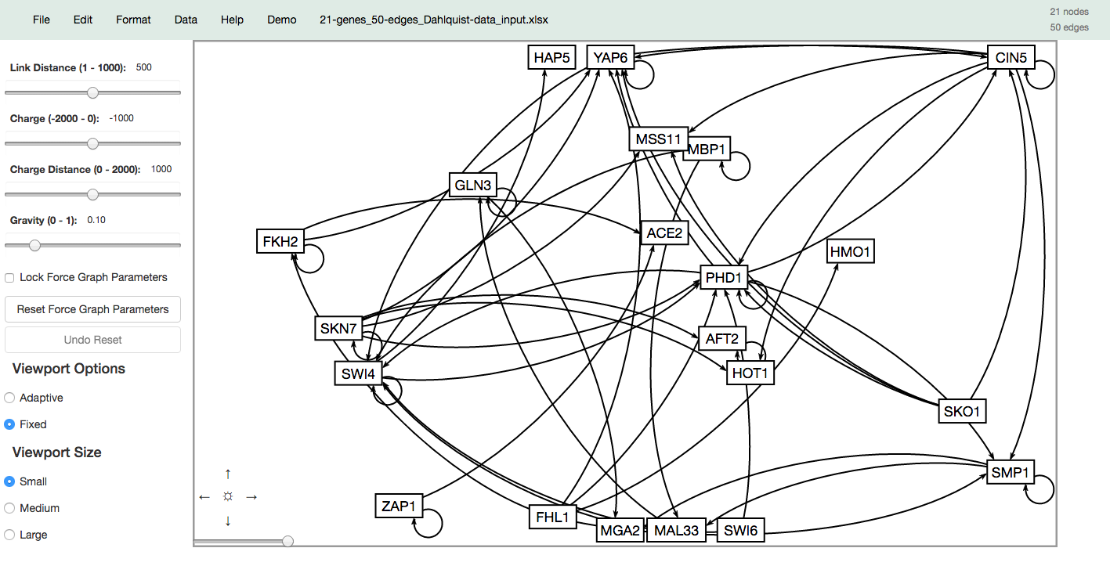
User Interface

Slide 9
Project Challenges
Differences in opinion between the clients and the developers
Working in a team
Messy Code
Dynamic resizing algorithm
Windows
Chrome/Firefox updates + extensions

Slide 10

Status Update
Layout tweaks
Prepare for release of next major version
Hierarchical/Alternate layouts

Slide 11
Demo

Slide 12
Questions?

